Slide 1
Insight on British Airways
In this presentation we use web scraping to scape the latest 400 comments on British Airways from Skytrax website to gain insight on our customers’ review

Slide 2
Sentiment Analysis
VADER (Valence Aware Dictionary and sEntiment Reasoner) is a lexicon and rule-based sentiment analysis tool that is specifically attuned to sentiments expressed in social media.
In the first analyze I use Vader library in python to analyze customer’s comments.
Vader will generate a compound score between -1(extreme negative) and 1(extreme positive) on each comments. This is the most useful metric if you want a single unidimensional measure of sentiment for a given sentence
Scoring
For the case of British Airline, I set compound score of
>0.75 as positive
<0.5 and <0.75 as neutral
>0.0and<0.5 as negative
<0.0 as very negative

Slide 3
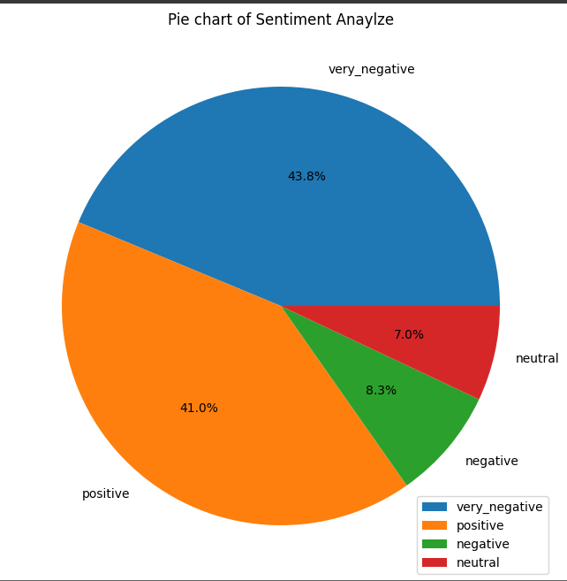
The diagram is the pie chart representation of sentiment analyze.
We can see that 52.1% of comments under the websites is either negative(8.3%) or very negative(43.8%).
Positive comment is only 41% which means a great amount of effort need to be exert on improving our customers’ experience

Slide 4
Word Cloud
After that, a word cloud is generated using all the text in the 400 comments to visualize what is some of the common words that we need to pay attention on to improve our customers’ experience with us.

Slide 5
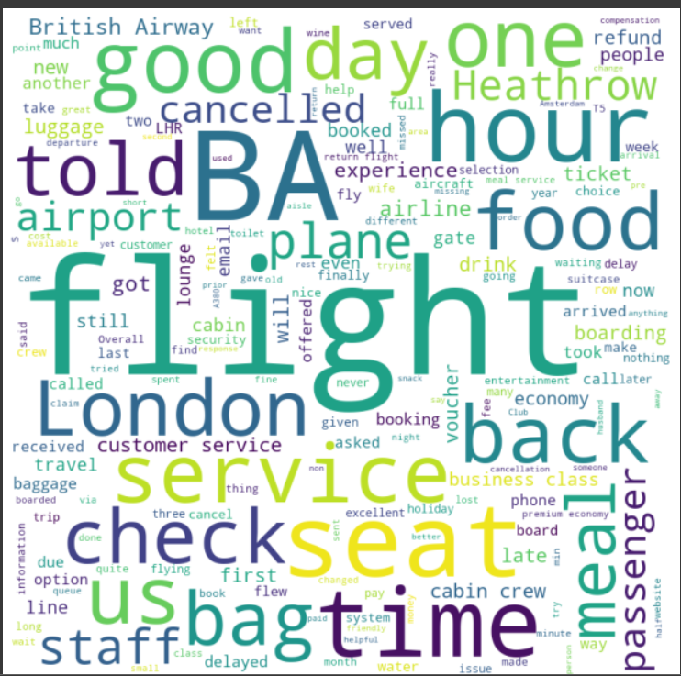
Insight on Word Cloud
“Service”, “food”, “staff”, “meal”, “seat”
These are some of the keywords that is the most common in the 400 comments.
“Food” and “meal” is two of them, so I suggest that British Airways should investigate their flight meal and make some improvement on it since it is appearing frequently.
“Service”, “Seat” and “Staff” indicate that there is something wrong with our flights’ customer experience, we should stress more on this area to improve our company’s flight experience.

Slide 6
Thank You !
Link to the jupyter notebook:
https://colab.research.google.com/drive/1WOu1PvovAO9bthdGcy5ZFxGD9Upu8wbS?usp=sharing

